Slide 1
Team :ELECTRONICS INVENTORS
Team Members :
Sai Ganesh Peram (team lead)
Davanaboyana Venkatesh
Sai Kiran Yerrangi
Sai Ganesh peram
Mail Id :
Sai Ganesh Peram (team lead) – peramlakshmi09@gmail.com
Davanaboyana Venkatesh – dvenkatesh113@gmail.com
Sai Kiran Yerrangi – saikiran818499@gmail.com
Sai Ganesh Peram – ganeshgana5712@gmail.com
Project Id : SPS_PRO_364
Project Title :
Predicting The Energy Output Of Wind Turbine Based On Weather Condition
Category :
Machine Learning

Slide 2
PREDICTING THE ENERGY OUTPUT OF WIND-TURBINE BASED ON WEATHER CONDITIONS

Slide 3
INTRODUCTION
The re-emergence of the wind as a significant source of the world’s energy must rank as one of the significant developments of the late 20th century. The first windmills on record were built by Persians around 900 A.D. These vertical axis windmills were not very efficient at capturing the wind’s power and were particularly susceptible to damage during high winds. During the middle Ages, wind turbines began to appear in Europe. These turbines resembled the 4-bladed horizontal axis windmill typically associated with Holland. The applications of windmills in Europe included water pumping, grinding grain, sawing wood and powering tools. Like modern wind turbines, the early European systems had 2 degree of freedom that allowed the turbine to turn into the wind to capture the most power. The use of windmills in Europe reached their height in the 19th century just before the onset of the Industrial Revolution. At this time, windmill designs were beginning to include some of the same features found on modern wind turbines including yaw drive systems, air foil shaped blades and a power limiting control system. Wind turbines have continued to evolve over the past 20 years and the overall cost of energy required to produce electricity from wind is now competitive with traditional fossil fuel energy sources. This reduction in wind energy cost is the result of improved aerodynamic designs, advanced materials, improved power electronics, advanced control strategies and rigorous component testing. Over the last 25 years, wind turbines have evolved and are now cost competitive with traditional energy sources in many locations. The size of the largest commercial wind turbines, has increased from approximately 50 kW to 2 MW, with machines up to 5 MW under design .

Slide 4
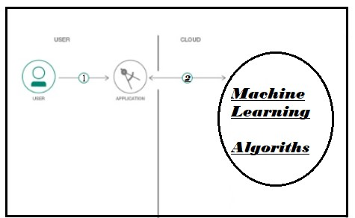
BLOCK DIAGRAM :

Slide 5
ADVANTAGES & DISADVANTAGES :
Advantages:
By this Model we save more money such that it is cost-effective.
Due to this model we can come to know where we can place this turbine to get more output energy.
Our model has other advantage that, turbine will automatically switch-off when air speed reaches more than saturation point.
Such that it will save a lot of money.
As in real world we are predicting air speed for our satellite launchings we can find such data easily so we don’t need to predict weather conditions and we can use them easily and we can predict our output of turbine easily.
Disadvantages:
As it is not a dynamic ui we need to give the predicted values of Air speed, Air density, temperature. This disadvantage can become a advantage too , by linking live data to our ui
CONCLUSION:
This Machine Learning - predicting model can predict the energy output of wind turbine based on weather condition mainly based on air speed.
FUTURE SCOPE :
This Model has great future scope because , in future we should depend more on renewable energy sources in that one of the energy source is Wind Turbine, so we have more future scope due advantages of our model .

